Slide 1
PREDICTIVE MODEL FOR METAL CONCENTRATION IN CONSUMER GOODS
BY NAMPEERA SHATRAH IRENE
30th APRIL, 2026

Slide 2
Introduction
The objective of this project is to predict metal concentration in consumer products based on their characteristics (e.g., Lead ppm, cadmium, mercury, arsenic ppm)
Dataset: Consumer product testing data
Data source
https://data.cityofnewyork.us/Health/Metal-Content-of-Consumer-Products-Tested-by-the-N/da9u-wz3r/about_data
This dataset contains 8494 rows each being a laboratory test result and 11 columns which include; product type, product name, metal concentration, units, made in country among other records
Goal: Improve safety analysis using Machine learning

Slide 3
Data Cleaning & Preparation
Missing values were handled to maintain dataset consistency
Categorical features were transformed using encoding techniques
Numerical variables were normalized to ensure uniform scaling
Duplicate entries were removed to prevent data leakage

Slide 4
Exploratory Data Analysis
Analyzed key data distributions to understand metal concentration patterns
Examined relationships between variables using correlation analysis
Observed significant variation in metal levels across product categories

Slide 5
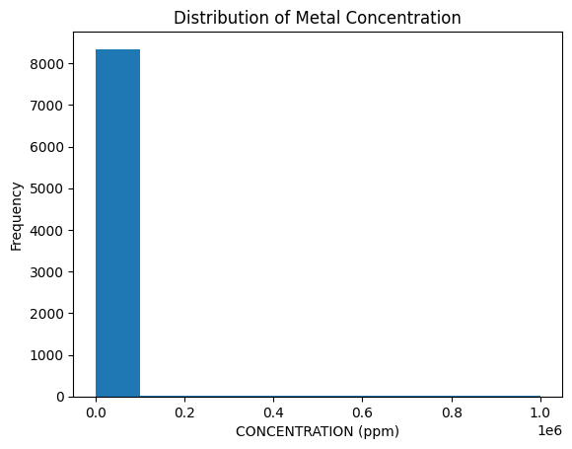
METAL CONCENTRATION
Text
Most products have low metal concentration, but a few extreme values indicate potentially hazardous contamination.

Slide 6
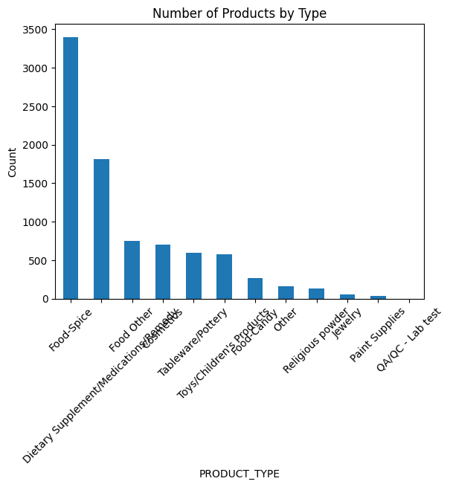
NUMBER OF PRODUCTS BY TYPE
Certain product types dominate the dataset, suggesting targeted testing or higher exposure risk.

Slide 7
Concentration by the top 10 countries
The data set showed that most of the countries with the highest metal concentration were not known but from the known ones India was the leading country in producing contaminated products that is they had high metal concentration which is so risky for peoples health

Slide 8
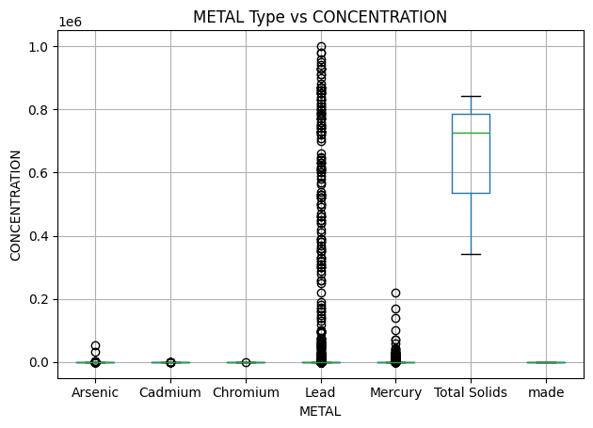
Box plot shows concentration across the metals
The box plot compares the concentration across metal
Lead shows the highest variability and extreme values Many outliers indicate some products contain very high lead concentrations, making it the most concerning metal.
Total Solids have consistently high concentration levels Unlike other metals, values are concentrated at a higher range, suggesting it behaves differently from toxic metals.

Slide 9
Conti…..
Mercury shows moderate variation with some outliers This indicates occasional high contamination but less extreme than lead.
Arsenic, Cadmium, and Chromium have relatively low concentrations Most values are close to zero, suggesting lower contamination levels in tested products.
Presence of many outliers across metals → Indicates irregular contamination patterns, possibly due to differences in product types or sources.

Slide 10
Modeling approach
Random Forest: Random Forest is an ensemble method that builds multiple decision trees and averages their predictions. It’s known for its accuracy and robustness, it works with many numerical and categorical features and is resistant to outliers.
Neural network: starts with random weights and later produces the final prediction for dataset. It then calculates the loss or how far off the predictions are from the actual values

Slide 11
Results
Certain product types show consistently higher contamination levels
Country of origin significantly influences contamination risk
Model successfully identifies high-risk products for prioritization

Slide 12
Random forest
Features from the dataset don’t strongly show contamination
Summary: Random Forest is the most balanced and accurate model. It handles both false positives and false negatives well, making it a strong candidate for deployment
Random Forest Predictions:
[0.00000000e+00 0.00000000e+00 3.39326667e-01 6.36871067e+02
0.00000000e+00]
this indicates that the dataset has many low or near zero contamination values which is a good indicator that most of the goods have low metal concentration.

Slide 13
Neural network
The results show inconsistency in the data
neural Network (MLP) Predictions: 1326.25,817.28,443.96ppm
6581.07268197ppm is extremely a high estimation or over estimation

Slide 14
Comparing models
Random Forest
MSE: 2611008128.374824
R2: 0.6071951174101864
Neural Network (MLP)
MSE: 7674873883.080766
R2: -0.1546221943060866
The Random Forest model achieved an R² score of 0.607, indicating moderate predictive capability. In contrast, the Neural Network (MLP) produced a negative R² score of −0.155, meaning it performed worse than a baseline model that predicts the mean. This suggests that the neural network failed to learn meaningful patterns from the dataset. The results confirm that tree-based models are more suitable for this structured tabular dataset.

Slide 15
Conclusion
Neural networks are not universally superior—model performance depends heavily on data type. For structured tabular datasets, ensemble tree-based models are often more effective.

Slide 16
Future Work
- Use larger datasets because it makes predictions more reliable in real-world deployment
- Deploy model as an app because this turns the model into a usable product instead of just a notebook.
- Real-time monitoring integration, this detects when model stops performing well, helps retraining decisions and ensures reliability in production

